Slide 1

904 Chipola Street
Kannapolis, NC
(704) 932-9613 www.faithkannapolis.com
Thank you for joining us today!

Slide 2

PRAY daily for the
GYM ROOF PROJECT.
We need $35,000 to reach our goal of $60,000. Thank you for praying and giving as the Lord leads.

Slide 3

May GOD BLESS the return of our SUNDAY SCHOOL CLASSES this coming Sunday! This includes the running of our buses. Keep
praying as we adjust. Pray a special prayer
for each Sunday School teacher.

Slide 4

MEN, remember the prayer times…
Saturdays from 6:00-7:30 p.m.
Sundays at 9:30 a.m. and 5:30 p.m.

Slide 5

SIGN-UP DEADLINE for the Couples Banquet is today!
Cost is $20 per couple.
♥Great FOOD!
♥Great FUN!
♥Great FELLOWSHIP!

Slide 6
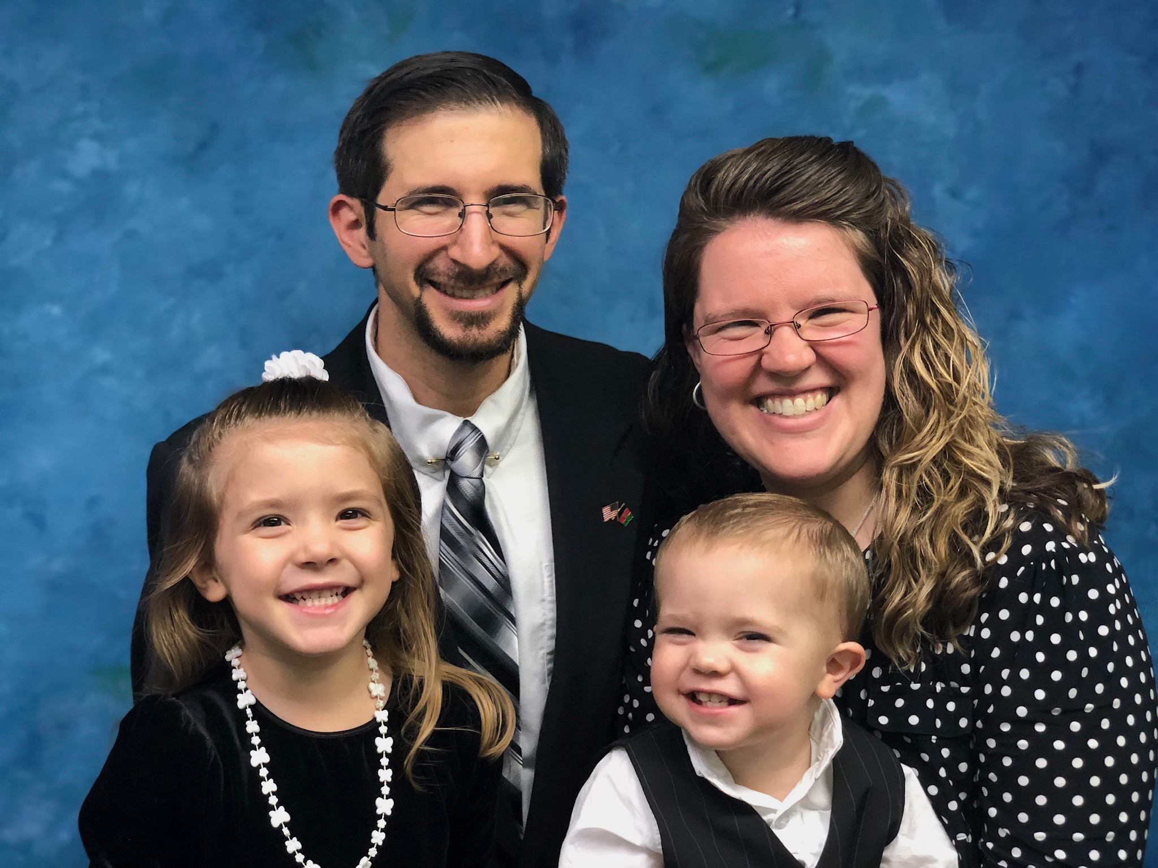
We are looking forward to
having Missionary Tim Stalcup and his family with us on Sunday, February 21st, during the evening service.

